Slide 1
DEPARTMENT OF THE BUILT ENVIRONMENT
Aalborg University

Slide 2
DEPARTMENT OF THE BUILT ENVIRONMENT
Climate change, urbanization, resource scarcity, population development and global migration pose major societal challenges in which research within the field of civil engineering and the built environment play a crucial role. We address these challenges.
We are rooted in the field of engineering, which is combined with important elements from the social sciences and humanities. This academic breadth is a strength since it offers the opportunity to research, advise and educate with a holistic approach solving the complex problems within urbanization, housing, construction and civil engineering.
Indsæt relevant billede
AALBORG
COPENHAGEN

Slide 3
REMARKABLE RESULTS, GRANTS AND AWARDS
Examples of key projects which we lead or participate in
ERC-Advanced grants: eCAPE
Marie Skłodowska-Curie Programme: LACONIA, Limnoplast, MonPlas
EU Horizon 2020 projects: COHSMO, MaRINET2, MOBISTYLE, ReCO2ST, RIBuild
Innovationsfond projects: CITIES, DiCyPS, DiRECTLY, REBUS, SIMS
EUDP: TetraSpar
Other Key projects: Danish Research Center for Freight Transport, MarinePlastic (Velux Fonden), FACTS (JPI OCEANS), Femern SafetyLab
Examples of awards received by employees
Det bæredygtige Element 2019 – Produktprisen; SUSTAINBLE BUILD Innovatør 2019; RA’s Støttefonds Forskningspris 2019; C. Allin Cornell CERRA Award 2019; Det bæredygtige Element 2018 – Personprisen; Professor P. Ole Fanger's Research Grant 2018; ROCKWOOL Prisen 2017; ELFORSK Prisen 2017; Bengt Turner Award 2014; Eddy Wastewater Principles/Processes medal 2013

Slide 4
KEY FIGURES
259 staff
App. 97 faculty members
App. 57 Post Doc/RA
App. 32 PhDs
More than 10 guest researchers
App. 63 TAP
App. 700 students
Total turnover DKK 236 million
External turnover DKK 126 million
Internal turnover DKK 53 million
Number of external projects > 335 on-going

Slide 5
ORGANISATION

Slide 6
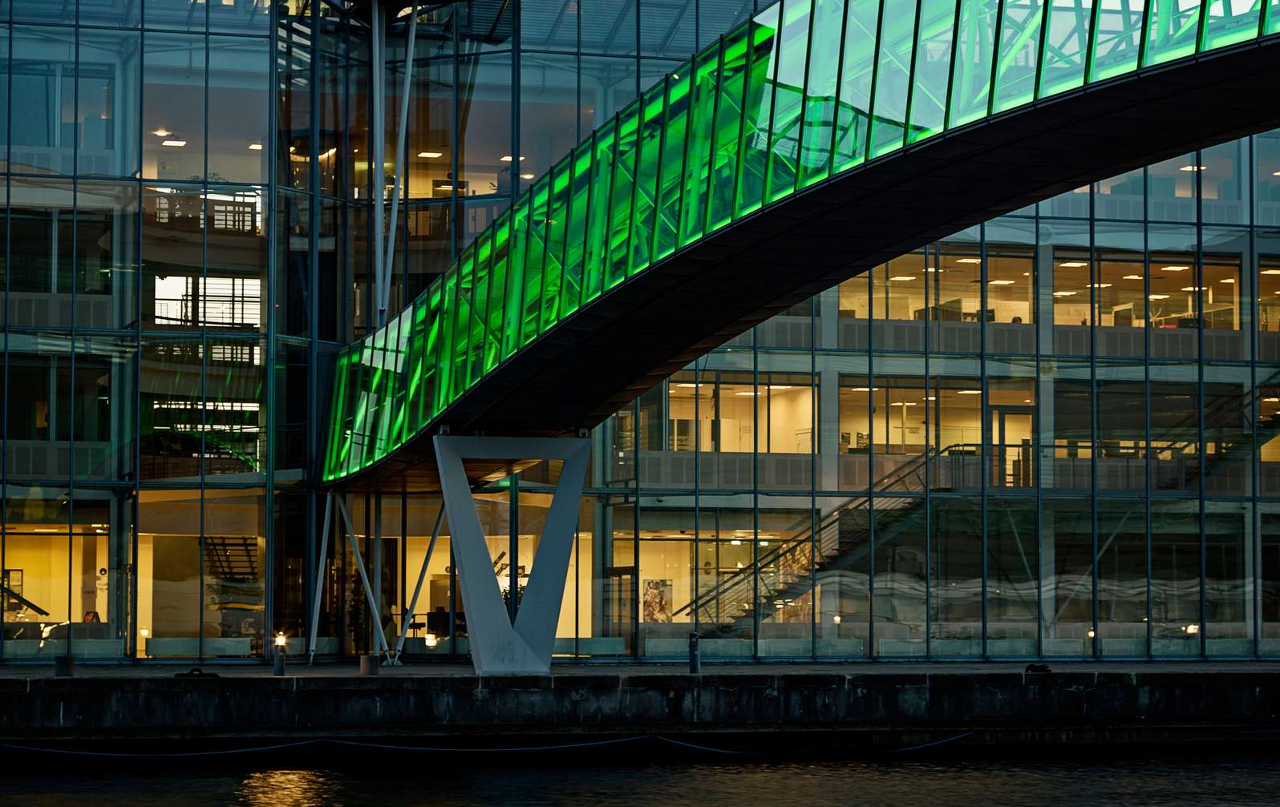
PUBLIC SECTOR SERVICE

Slide 7
PUBLIC SECTOR SERVICE
The Department of the Built Environment provides public sector service for the Danish Transport, Construction and Housing Authority.
The purpose is to provide
current, relevant and usable consultancy to support the public administration and the political system in the construction and housing area.
ground research and high quality communication hereof, which the authorities and the sector can use to raise quality and productivity in the construction and housing area, including accessibility.
Research includes
User Perspectives
Design, Function and Experience
Safety and Durability of Constructions
Indoor Environment
Energy and Ressource Efficiency
Value Creation in the Construction Process
Accessibility

Slide 8
EDUCATION

Slide 9
STUDY PROGRAMMES
BACHELOR
Aalborg
Byggeri og Anlæg
Geografi
BACHELOR OF ENGINEERING
Aalborg and Esbjerg
Byggeri og Anlæg
MASTER (CAND. POLYT.)
Aalborg
Byggeledelse
Indoor Environmental and Energy Engineering
Structural and Civil Engineering
Veje og Trafik
Water and Environmental Engineering
Esbjerg
Structural Design and Analysis
MASTER (CAND. SCIENT.)
Aalborg
Geography
MASTER (CAND. SOC.)
Copenhagen
By, Bolig og Bosætning
MASTER (CAND. TECH.)
Aalborg
Building Energy Design
Byggeledelse og Bygningsinformatik
Esbjerg
Risk and Safety Management
Copenhagen
Ledelse og Informatik i Byggeriet
CONTINUING EDUCATION
Master i Inkluderende arkitektur
Master i Bygningsfysik
Aalborg
Copenhagen
Esbjerg

Slide 10
STUDENTS Approx. 700 students in total

Slide 11
LABORATORIES

Slide 12
LABORATORY FACILITIES
Concrete Research
Energy and Indoor Environment of Buildings
Structural Research
Geotechnical Engineering
Ocean and Coastal Engineering
IT in Buildings
Chemical Analysis
Microplastics
The Environmental Hydraulics Laboratory
Traffic Research
Weather and Climate Observatory
The Virtual Flow Laboratory
Off-site Research Facilities
Air Quality Research
Light Research
Building Physics Research
Building Envelope Research

Slide 13
DIVISIONS AND RESEARCH GROUPS

Slide 14
RESEARCH

Slide 15
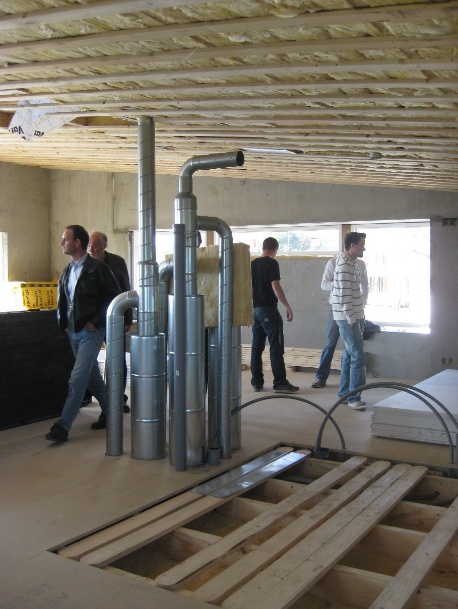
DIVISION OF ARCHITECTURAL ENGINEERING
KEY COMPETENCES:
Sustainable buildings
Zero-energy buildings
Integrated building design
Indoor environment
Natural, hybrid and mechanical ventilation
User systems for buildings
Smart operation and data analysis
Building Informatics
Notes:
Innovativt design af fundamenter til havvindmøller kan halvere prisen Et sugebøttefundament til en havvindmølle, der kan samles med bolte på havnen, inden det sejles ud til sin placering. Det nye design kan sænke prisen på fundamentet med op til 40 procent, og vil i sidste ende også sænke forbrugernes elregning. Derudover er installationen af designet yderst skånsomt for havmiljøet, og endelig er stålet i konstruktionen 100 genanvendeligt, når vindmøllen har udtjent sin levetid. https://www.engineering.aau.dk/nyheder-arrangementer/nyhed/innovativt-design-af-fundamenter-til-havvindmoeller-kan-naesten-halvere-prisen.cid366207
Nye algoritmer kan spare vindmølleejere for millioner AAU-forsker har udviklet flere algoritmer, som kan hjælpe vindmølleejere med at finde fejl i vindmøller, inden fejlene bliver problematiske. Det kan reducere omkostninger til inspektion, uforudsete reparationer og nedetid for vindmøllen markant. https://www.engineering.aau.dk/nyheder-arrangementer/nyhed/nye-algoritmer-kan-spare-vindmoelleejere-for-millioner.cid358148
Matematisk model giver domstole værdifuldt DNA-værktøj https://www.engineering.aau.dk/nyheder-arrangementer/nyhed/matematisk-model-giver-domstole-vaerdifuldt-dna-vaerktoej-.cid337018
Fremtidens batterier er lavet af svampe Forskere fra Aalborg Universitet har bygget verdens første batteri af biologisk materiale fra svampe. Teknologien er lige så effektiv som konventionelle batterier, men langt mere skånsom og bæredygtig for miljøet. Indenfor de kommende år vil den kunne revolutionere den måde, vi lagrer strøm på. https://www.engineering.aau.dk/nyheder-arrangementer/nyhed/fremtidens-batterier-er-lavet-af-svampe.cid364104

Slide 16
BUILDING INFORMATICS RESEARCH GROUP
RESEARCH FOCUS
Building Information Modelling (BIM)
Building data management and exchange
Formalisation of building processes and products from systems viewpoint
Knowledge representation and knowledge augmentation. Linked building data and semantic Web
Space and time dependent virtual building models
Artificial intelligence in the built environment
Computer-supported collaborative work
Intelligent buildings
Virtual and augmented reality

Slide 17
ENERGY IN BUILDINGS RESEARCH GROUP
RESEARCH FOCUS
Energy-efficiency of buildings and systems
Thermal building energy storage
Demand response and flexibility
User control and system interaction
Smart monitoring and energy management
Energy and building data analysis
Optimization of building operation
Natural building energy technologies (natural ventilation, passive solar heating, passive cooling, daylight, etc.)

Slide 18
INDOOR ENVIRONMENT AND SUSTAINABLE BUILDINGS RESEARCH GROUP
RESEARCH FOCUS
Indoor environment
Holistic evaluation methods for IE Quality
Sustainable buildings
Sustainable building materials
Life Cycle Assessment (LCA)

Slide 19
VENTILATION AND AIRFLOW IN BUILDINGS RESEARCH GROUP
RESEARCH FOCUS
Ventilations and air flow processes in buildings and building services
Thermal comfort and air quality
Air distribution and mass transport around persons
Determination of energy consumption, indoor climate and work environment
Risk assessment in connection with fire, dispersion of smoke, contamination, transport of bacteria and dispersion of gases in disasters

Slide 20
DIVISION OF BUILDING TECHNOLOGY AND MANAGEMENT
KEY COMPETENCES:
Building physics
Structural engineering
Construction management
Innovation
Digitalisation and data

Slide 21
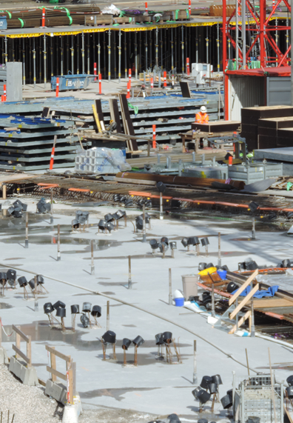
CONSTRUCTION MANAGEMENT AND INNOVATION RESEARCH GROUP
Indsæt billede, figur, illustration
RESEARCH FOCUS
Digitalisation and big data
Procurement and collaboration
Users and technologies
Productivity development
Regulation and framework conditions

Slide 22
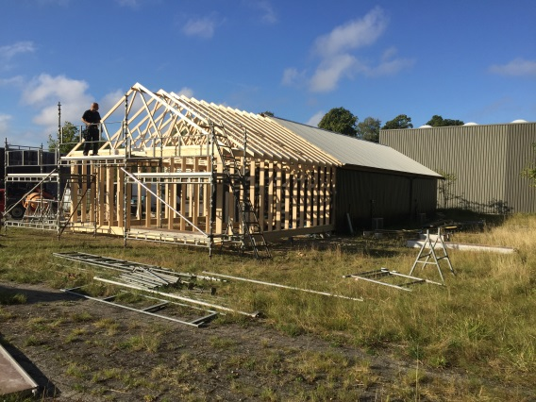
BUILDING PHYSICS AND STRUCTURAL ENGINEERING RESEARCH GROUP
Indsæt billede, figur, illustration
RESEARCH FOCUS
Building envelope and building physics - design and buildability
Construction and safety
Building acoustics and sound insulation
Durability and service life
Documentation of new materials
Recycling and reuse of materials
Building regulations
Climate change

Slide 23
DIVISION OF ENERGY EFFICIENCY, INDOOR CLIMATE AND SUSTAINABILITY OF BUILDINGS
KEY COMPETENCES:
Low-energy buildings
Energy efficiency
Sustainability
Indoor climate
Ventilation
Light in buildings

Slide 24
SUSTAINABILITY OF BUILDINGS RESEARCH GROUP
Indsæt billede, figur, illustration
RESEARCH FOCUS
Sustainability assessment of buildings
Life Cycle Assessment (LCA)
Circular economy
Materials and design strategies
Climate change impact
Embodied carbon

Slide 25
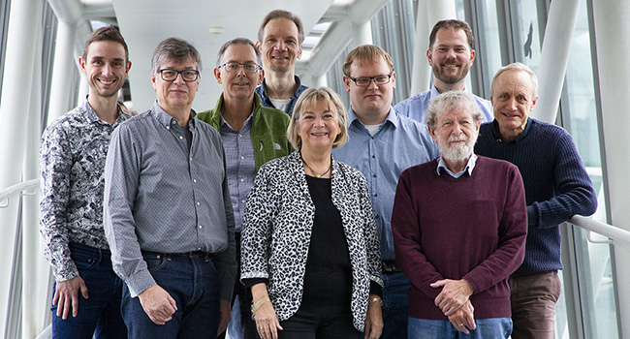
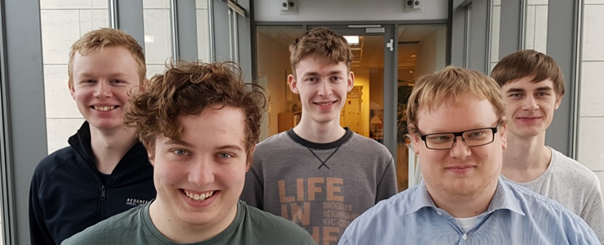
ENERGY EFFICIENCY RESEARCH GROUP
RESEARCH FOCUS
Energy efficiency
Heating and energy consumption
Integrated energy production in buildings
Energy requirements in building regulation
Zero-energy and plus-energy buildings
Thermal comfort in low-energy buildings
Demonstration projects
New tools for calculation of energy demand and indoor climate
User experiences and satisfaction with energy-efficient construction

Slide 26
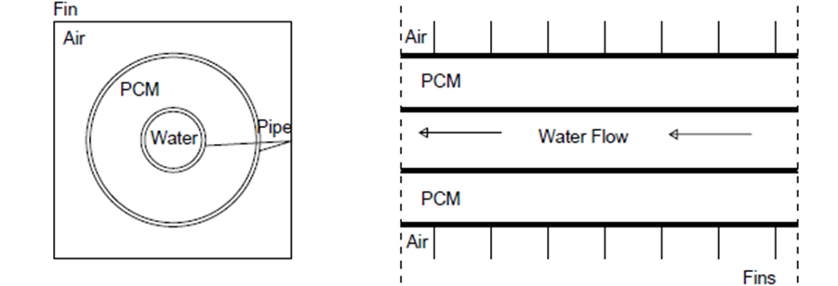
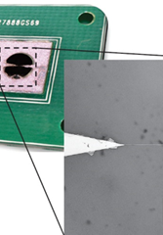
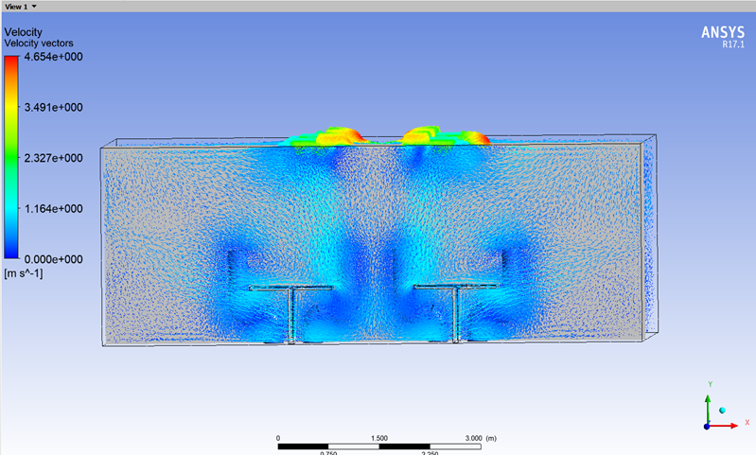
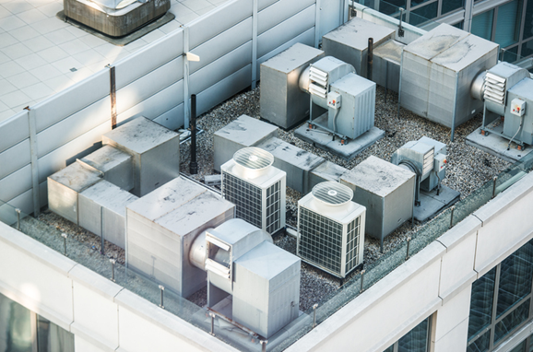
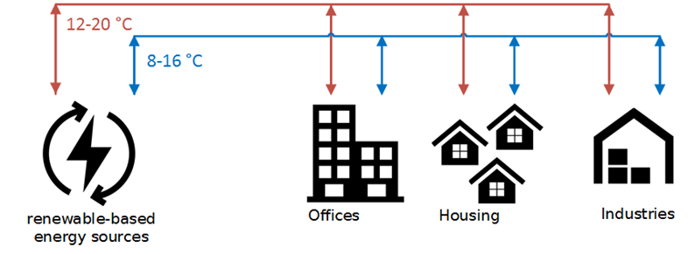
HEATING VENTILATING AND AIR-CONDITIONING RESEARCH GROUP
RESEARCH FOCUS
Energy efficient ventilation, heating and cooling in buildings
Thermal conditions in buildings
Air cleaning and filtration
Control systems
Communication between indoor climate systems and grids
Near room temperature heating and cooling systems
Near room temperature district heating systems

Slide 27
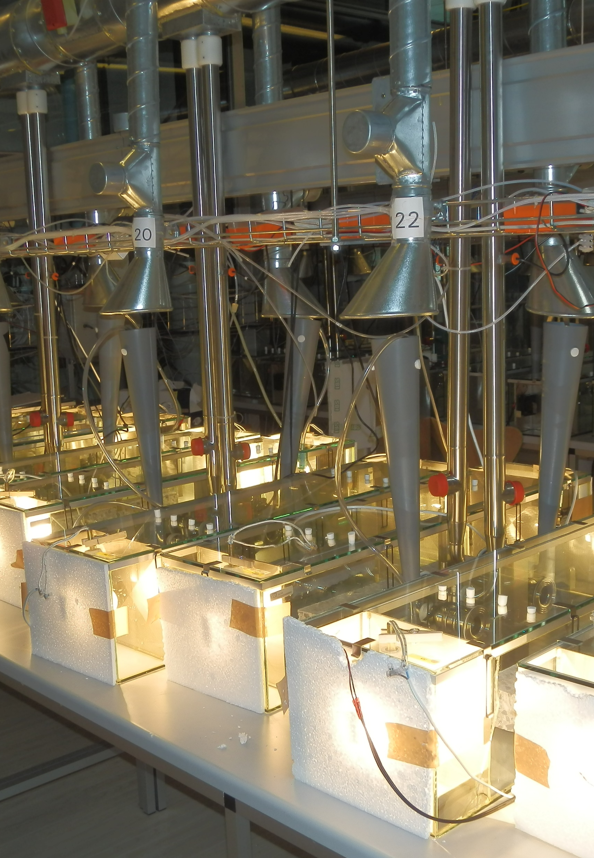
INDOOR HEALTH IMPACTS RESEARCH GROUP
Indsæt billede, figur, illustration
RESEARCH FOCUS
Indoor air quality
Indoor pollutions sources
Thermal comfort
PCB
Mold and moisture problems
SVOC and VOC
User behaviour

Slide 28
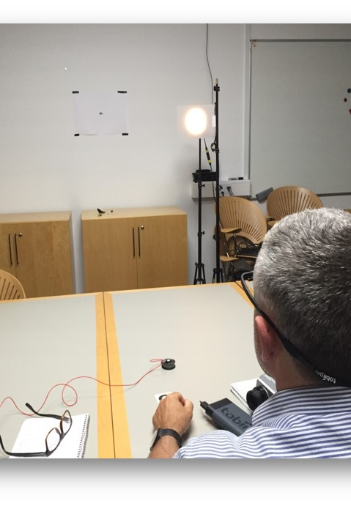
LIGHT IN THE BUILT ENVIRONMENT RESEARCH GROUP
Indsæt billede, figur, illustration
RESEARCH FOCUS
Daylight
Electric lighting
Lighting control systems
User behavior
Energy consumption
Perception

Slide 29
DIVISION OF MARINE AND ENVIRONMENTAL ENGINEERING
KEY COMPETENCES:
Microplastics
Hydraulics
Physical geography
Rain and waste water run-off
Port and coastal structures
Offshore constructions
Floating wind turbines
Wave energy converters

Slide 30
OCEAN AND COASTAL ENGINEERING RESEARCH GROUP
RESEARCH FOCUS
Breakwaters
Coastal structure
Ocean waves and hydrodynamic modelling
Wave Energy Converters
Floating Wind Turbines
Mooring of floating bodies

Slide 31
URBAN POLLUTION RESEARCH GROUP
RESEARCH FOCUS
Biological and chemical process engineering of sewer networks
Urban polluted waters, their treatment and interactions with the environment
Microplastic pollution of the environment
Stormwater management
In-sewer processes

Slide 32
URBAN SOIL RESEARCH GROUP
RESEARCH FOCUS
Measurement and modeling of water, oxygen, chemical and particle transport in soil and groundwater systems.
Characterization of air, moisture, and heat properties for soil-based, high-porosity building materials (collaboration with Architectural Engineering).
Run-off from urban soil/urban green areas (collaboration with Urban Water).
Risk assessment and protection of groundwater resources (collaboration with WatsonC).
Design of soil, e.g. using glacial rock flour for improving soil functions for productivity and retaining chemicals, and reduced-gravity soil simulants for life support systems in space.
Deposit of glacial rock flour at Upernaviasuk, Greenland

Slide 33
URBAN WATER RESEARCH GROUP
RESEARCH FOCUS
Movement of water from the time when the drops are formed in the atmosphere until the water ends up in the ocean
Evaluation of the effects of the human-induced impact on the local urban environment and the more distant open environment
Atmospheric processes in especially wind and rain, and their correlation with climatic conditions in the city

Slide 34
DIVISION OF STRUCTURES, MATERIALS AND GEOTECHNICS
KEY COMPETENCES:
Analyses of complex, load-bearing structures (offshore structures, wind turbines, shell structures and large bridges)
Construction management
Reliability and risk analysis
Fracture mechanics
Geotechnics
Material modelling
Vibrations

Slide 35
CONSTRUCTION MANAGEMENT RESEARCH GROUP
RESEARCH FOCUS
Management of a construction project from the idea phase through programming, design, construction, operation to dismantling/reuse
Develop management control systems
Resource management
Information modelling

Slide 36
GEOTECHNICAL ENGINEERING RESEARCH GROUP
RESEARCH FOCUS
Understanding and modelling of scour and sedimentation
Understanding and modelling of debris flow
Large deformations in saturated granular materials and liquefaction
Design and development of foundations for offshore wind turbines
Models for the determination of forces from ocean waves and current on structures

Slide 37
RELIABILITY AND RISK ANALYSIS RESEARCH GROUP
RESEARCH FOCUS
Rational and sustainable decision-making for engineering structures (buildings, bridges, offshore structures and renewable energy structures)
Reliability analysis

Slide 38
RISK, RESILIENCE AND SUSTAINABILITY IN THE BUILT ENVIRONMENT RESEARCH GROUP
RESEARCH FOCUS
Probabilistic systems modelling
Risk informed decision-making
Resilience of systems
Sustainability of systems
Natural hazards risk management

Slide 39
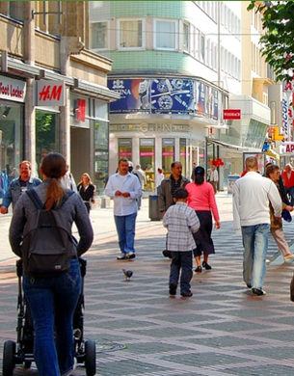
DIVISION OF TOWN, HOUSING AND PROPERTY
KEY COMPETENCES:
Sustainable cities
Universal design and accessibility
Urbanisation and regional change
Housing and segregation
Urban development and transformation
Consumption patterns

Slide 40
SUSTAINABLE CITIES AND EVERYDAY PRACTICE RESEARCH GROUP
Indsæt billede, figur, illustration
RESEARCH FOCUS
Everyday life and sustainability
Household consumption patterns
Residential energy consumption
Smart home technologies in real life use
Consumption-production relations and prosumers
Sustainable urban development
Local approaches to sustainability
Sustainable transitions of provision and consumption

Slide 41
TRANSFORMATION OF HOUSING AND PLACES RESEARCH GROUP
Indsæt billede, figur, illustration
RESEARCH FOCUS
Urbanisation, residential mobility, and regional migration patterns
The relationship between architecture and everyday life
Housing and settlement preferences, demographic changes and changed lifestyles
Transformation of disadvantaged neighbourhoods including social life and neighbourhood effects
Strategic development in outer areas
Migration, urban diversity and social cohesion
The effect of technological and environmental change on people

Slide 42
UNIVERSAL DESIGN AND ACCESSIBILITY RESEARCH GROUP
RESEARCH FOCUS
Universal design; spacial design, daylight, wayfinding etc.
Accessibility and usability
Architectural and sensory quality
User needs, involvement of users and understanding of users
Design process
Building legislation

Slide 43
DIVISION OF TRANSPORTATION ENGINEERING
KEY COMPETENCES:
Traffic safety
Traffic planning
Traffic management
Digital road design
Intelligent transport systems
Freight and logistics

Slide 44
FREIGHT TRANSPORT RESEARCH GROUP
RESEARCH FOCUS
Optimization of freight transport through the use of new technologies, in particular tracking technologies and blockchain technology
Collaborative logistics among large logistics companies
Multimodal transport and port management
Optimization of freight delivery in urban areas
Minimization of environmental impacts of freight transport

Slide 45
TRAFFIC RESEARCH GROUP
RESEARCH FOCUS
Traffic safety of roads, road users and vehicles
Safe road design and development of safe vehicle technology
Analysis of large data set and index studies
On-demand public and private transport
Machin learning in traffic management

Slide 46
ROAD MODELLING RESEARCH GROUP
RESEARCH FOCUS
Road modelling and design within the BIM Lifecycle paradigm
Infrastructure modelling towards a Digital Twin concept
Augmented Reality as medium between model and physical infrastructure information

Slide 47
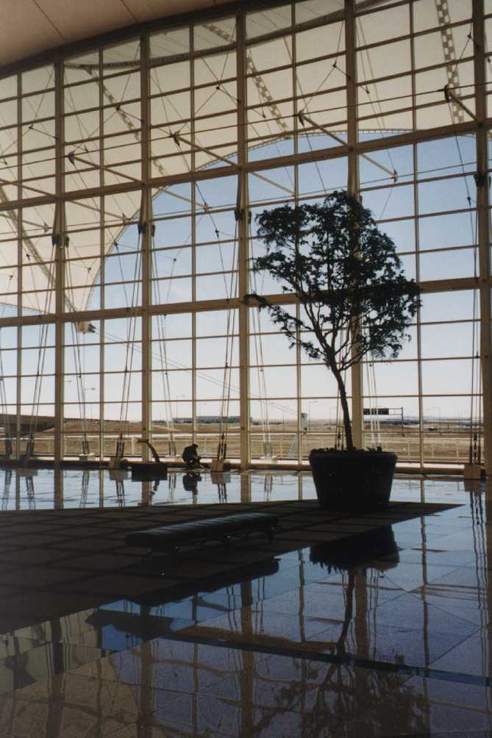
REARCH CENTERS

Slide 48
CENTER FOR FOOD SCIENCE,
DESIGN & EXPERIENCE
We work with sustainable innovation, food, aesthetics and life quality in everyday life.

